Slide 1
Kronos Kidnapping Case
Heather Lemon
COMP 4449 Capstone
May 24, 2023

Slide 2
Case Background
GASTech employees profited from the 2014 IPO. During the company celebration, employees went missing, and the Protectors of Kronos (POK) activist group are suspected of the disappearances. This presentation presents the speculative findings for your judgment.

Slide 3
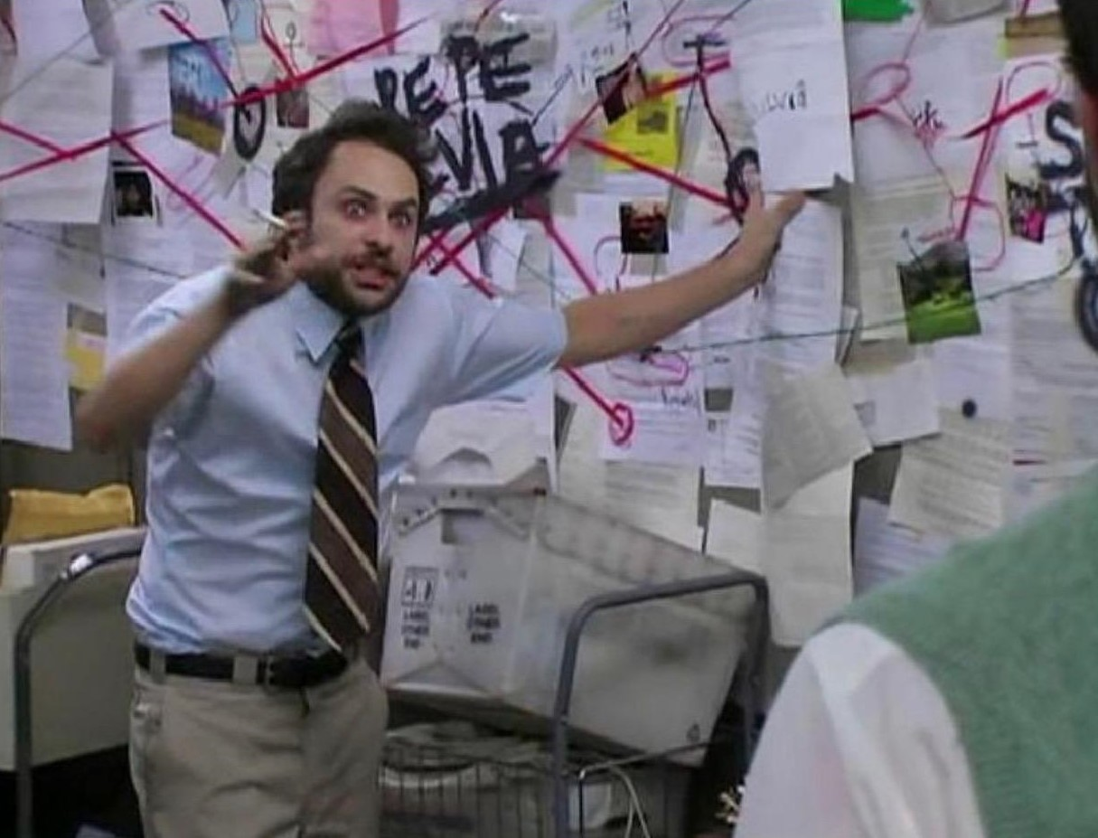
Notes:
This was my feelings toward the project the past month and a half.
So, we are going to play a game of Clue to figure out what exactly is happening in Kronos surrounding the POK members, GASTech and the government/citizens.

Slide 4
Dataset Description
A map of Kronos
A chart describing the local GAStech organization, in PDF format.
A spreadsheet of GAStech employee records
Email headers from two weeks of internal GAStech company email
Resumes and short biographies of many, but not all, of the GAStech employees, in Microsoft Word format
Historical reports and descriptions of the countries involved, in Microsoft Word format
Relevant current and historical news reports from multiple domestic and translated foreign sources, in text file format.
Notes:
We have been given a map, an org chart of GASTech, Employee records, email headers of 2 weeks prior to the kidnapping, a few employee resumes, factsheet of kronos and historical reports, and news articles.

Slide 5
2 Hypotheses of what happened
Question: Did the CEO and executives fake a kidnapping and steal the money and run away?
Question: Did the POK kidnap the CEO and executives to extort money for funding drugs, corruption and bribery?
Answer: My hypothesis is that both incidents occurred.

Slide 6
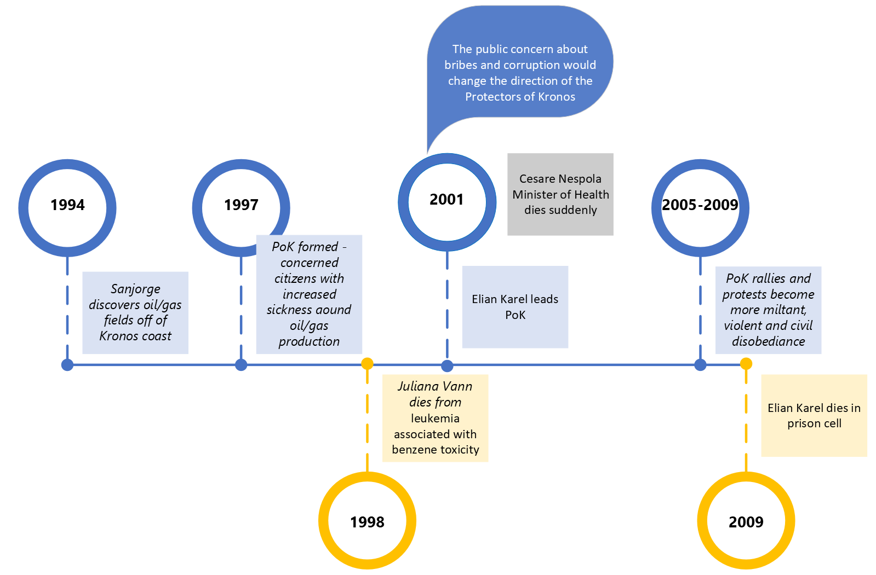
Historical Background of POK
DATA SOURCES
Historical reports and descriptions of the countries involved
News reports from multiple domestic and translated foreign sources, in text file
Blue represents GASTech or POK activity
Gold represents deaths
Notes:
The POK was formed from concerned citizens about environmental issues from GASTech gas and oil drilling need a local river.
The important part to take away is two people died, one Juliana drank contaminated river water and Karel died while being detained in a prison cell for 3 months on tax evasion charges.
Conflict reports show he either died of a heart attack or was brutally beaten to death. So far the government has done nothing to help its people.

Slide 7
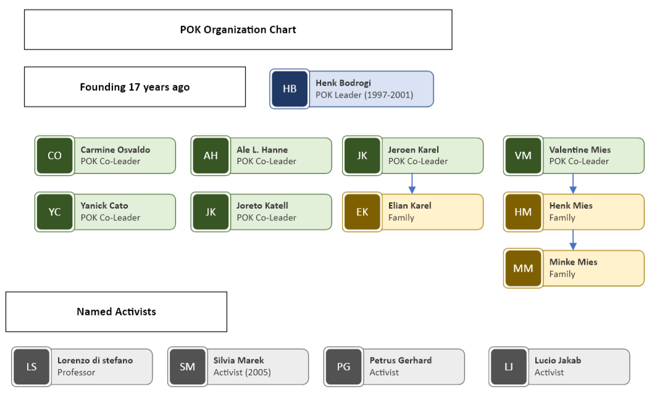
Founding Structure of POK Network
Notes:
Henk Bodrogi is the founder and leader with 6 other co-leaders and 4 named activists.

Slide 8
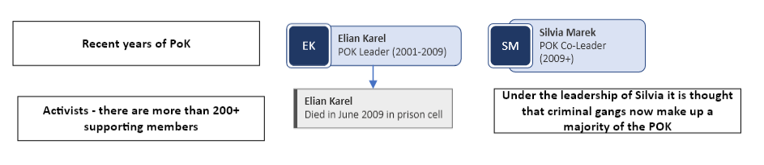
Recent Structure of POK Network
Notes:
Elian dies in a prison cell in 2009, Silvia takes over the POK for the past 5 years.

Slide 9
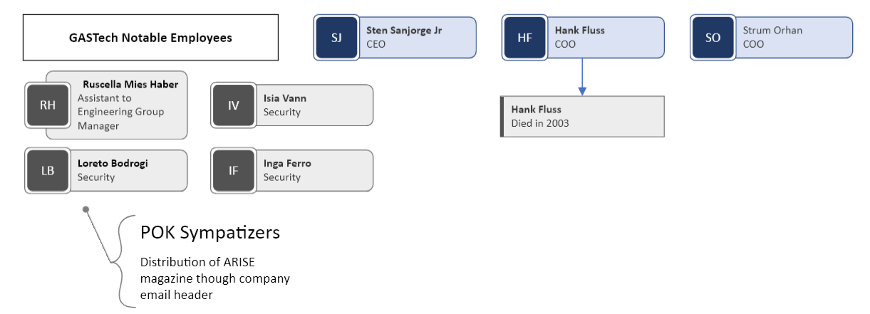
GASTech Notable Employees

Slide 10
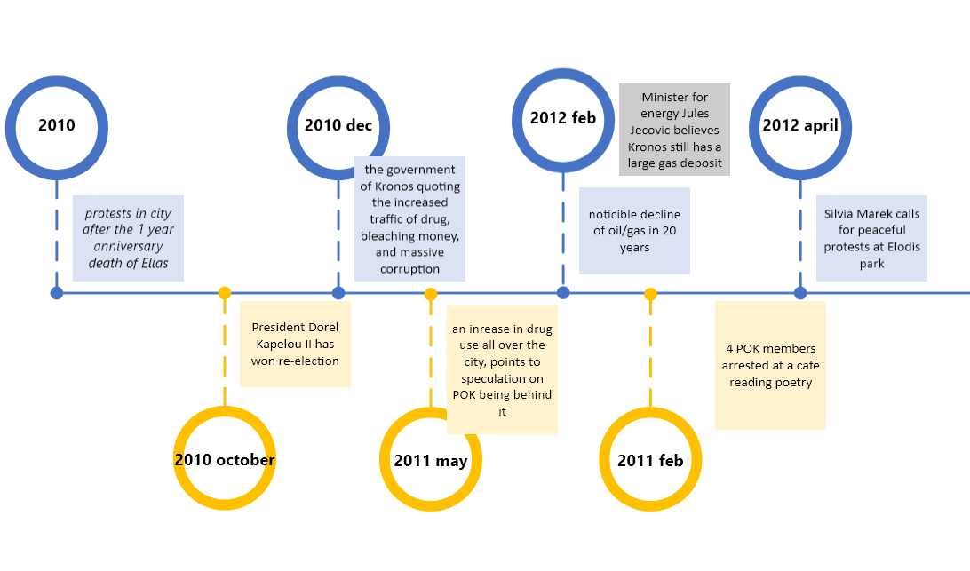
Timeline 2010-2012
Notes:
Protests continue, drug trafficking and usage is on the rise. A decline in oil/gas for the first time in 20 years.

Slide 11
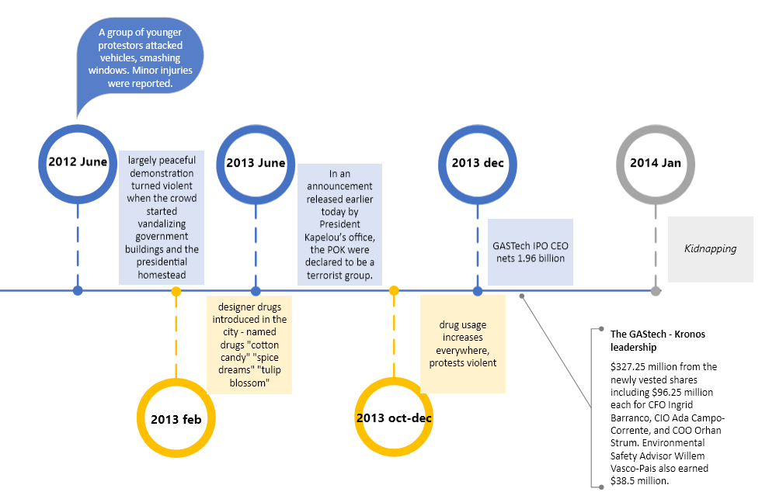
Timeline 2012-2014
Notes:
Protests turn violent, designer drugs appear, POK is now labeled as a terrorist group, GASTech IPO announced, then kidnapping occurs in Jan 2014.

Slide 12
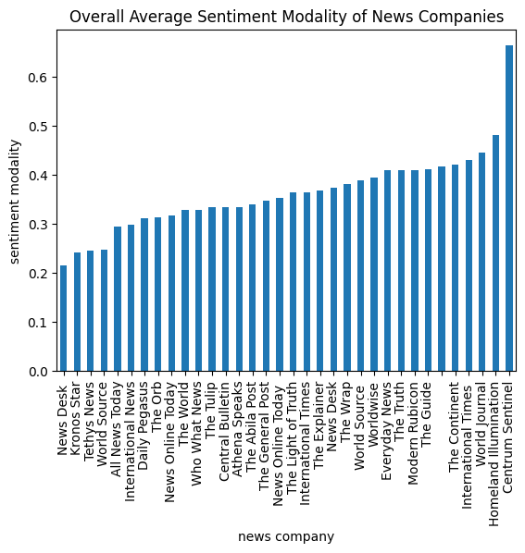
News Article Facts vs Opinions
Briefly wanted to point out the news articles of facts vs opinions. The Kronos Star has the least amount of bias when reporting their news articles. The timeline for the kidnapping will follow the Kronos Star reporting timeline.
Notes:
Sentiment analysis of news articles with the Pattern library, modality is a rating from 0 to 1 if something is more like a fact its closer to 0 and something that’s an opinion is closer to a 1.

Slide 13
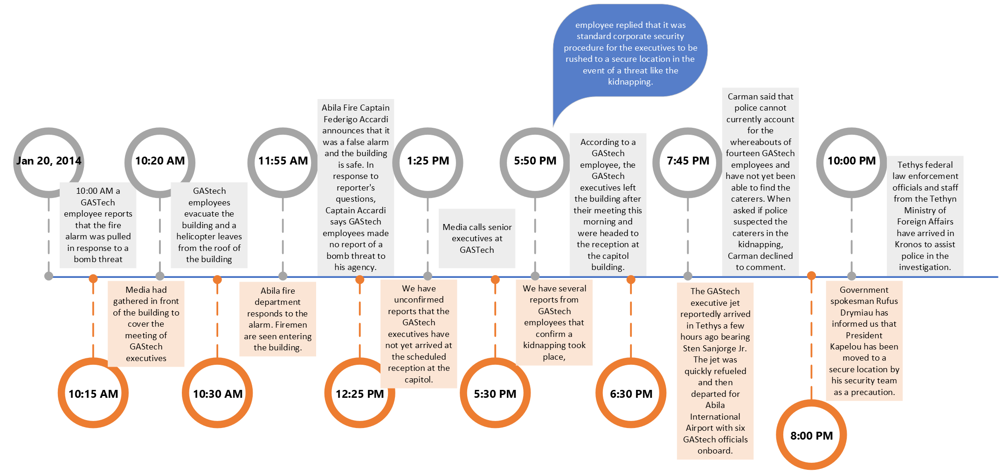
Kidnapping Timeline Events January 20-21
Notes:
At 10:00 AM the fire alarm was pulled; media were already gathered out front for news coverage of the reception at the capital. Fire department responds and told everyone it was a false alarm. There is no fire or bomb threat.
At the same time that employees exited, a helicopter took off from the roof of the building. The media tries calling senior executives but no response. At 6:30 PM a jet arrives to refuel and takes off for Ablia airport with 6 other GASTech employees. The police suspect POK behind the alleged kidnapping, the president of Kronos was moved to a secure location and several law enforcement officials arrived in Kronos to assist the police with the investigation.

Slide 14
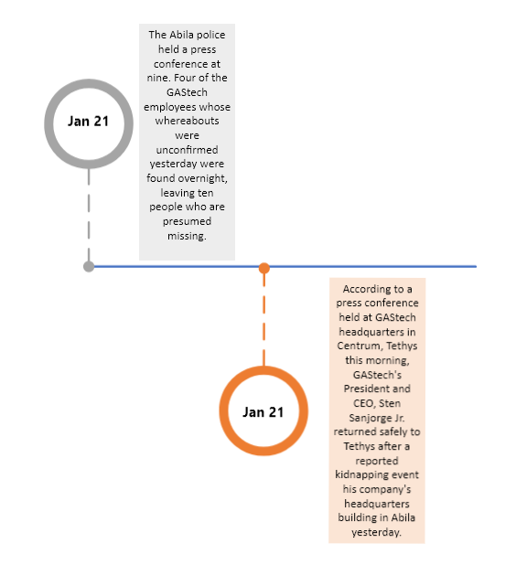
Kidnapping Timeline Events January 20-21
Notes:
The 21st was just a review of what had happened the previous day. 4/10 employees were found and the CEO returned safely after the kidnapping.

Slide 15
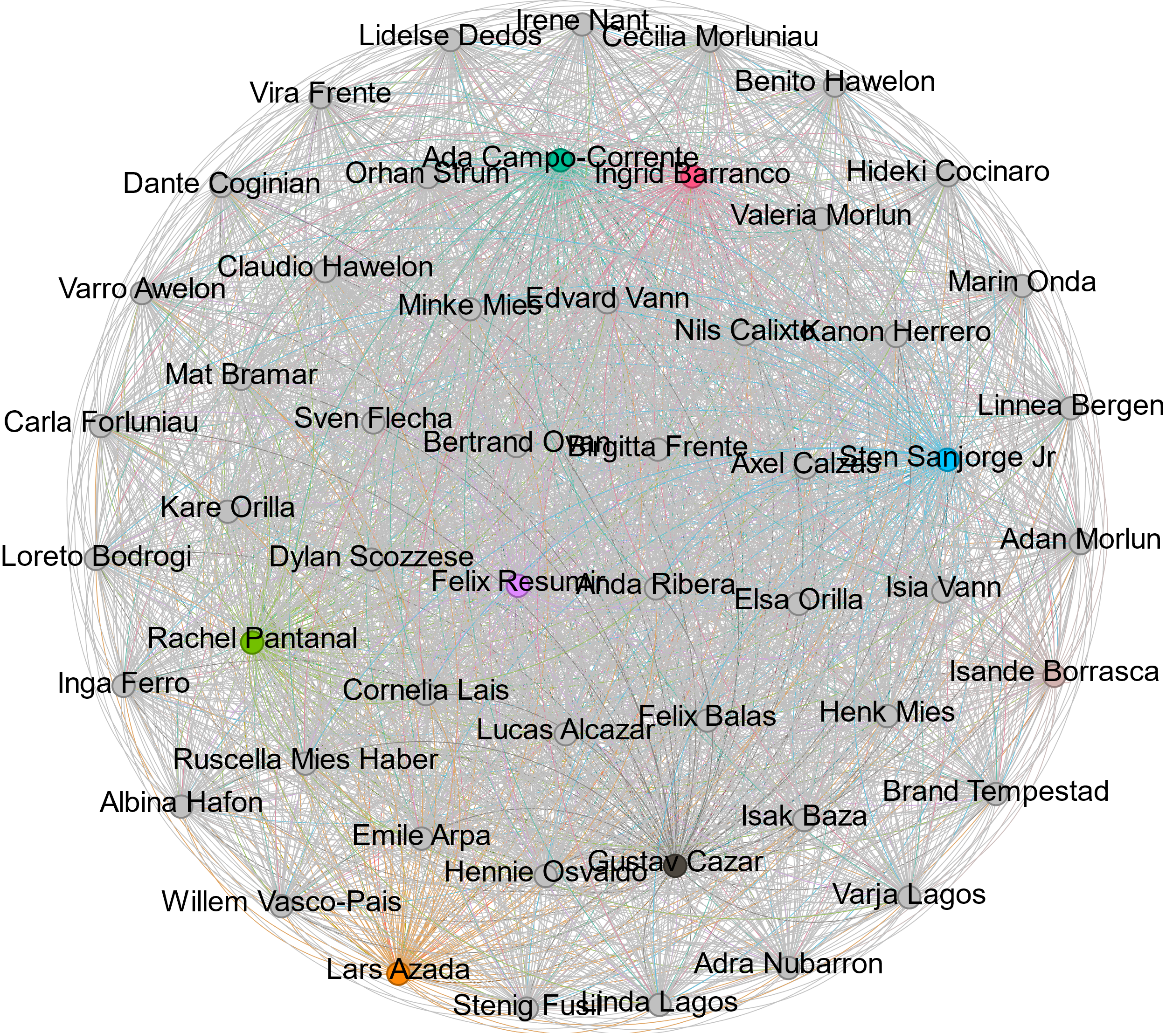
Social Network Graph of GASTech Email
https://gephi.org/
Proves the point of executives made $$$ and left
Pulled from email headers csv file
4 of 9 Senior Executives:
Sten Sanjorge Jr
Ingrid Barranco
Rachel Pantanal
Ada Campo-Corrente
Notes:
I used gephi to draw a social network communication graph from the email header data. The brightly colored nodes are the ones with the most frequent communication with each other.
You just need a source, target, and weight, for weight I calculated the frequency at which people sent emails to each other. For example Felix sent Rachel 2 emails.

Slide 16
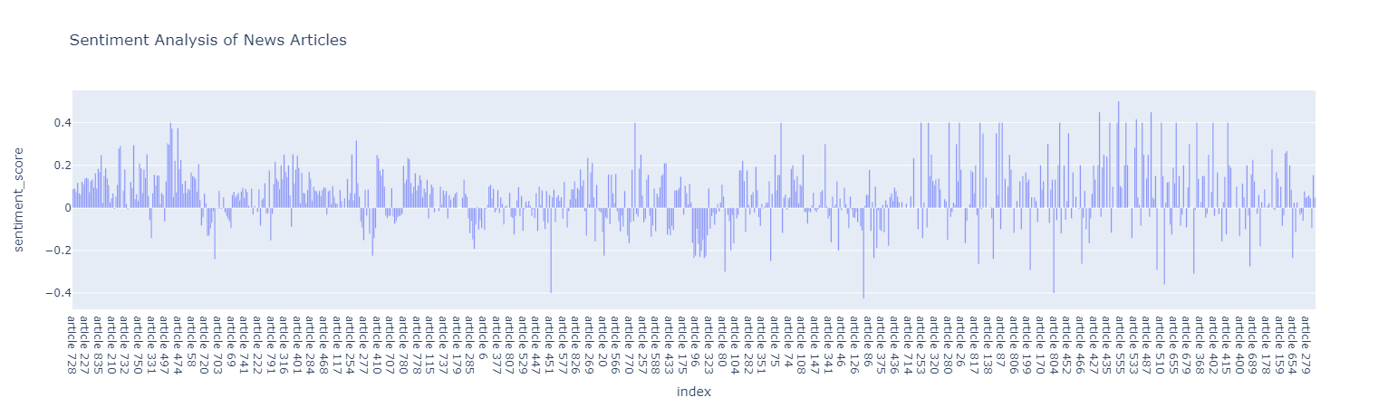
Sentiment Analysis of News Articles over Time ~20 years
Mapped 20 years of data to show positive or negative sentiment. This shows that it is positive initially, however overtime it is becoming more mixed sentiment.
Since it is moving more from + to -, Are the citizens of Kronos become discontent with the country?

Slide 17
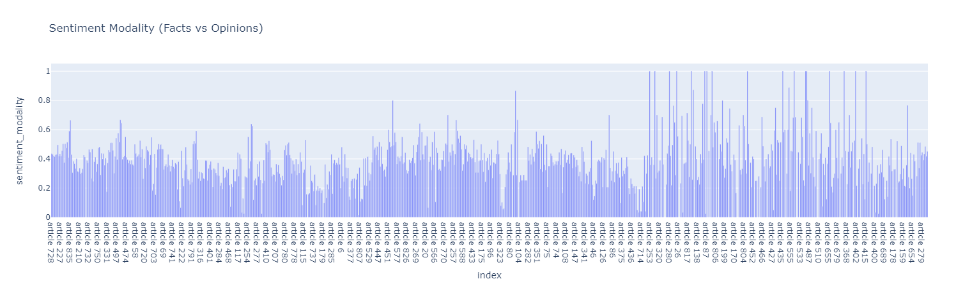
Sentiment Modality of News Articles over Time ~20 years
Mapped 20 years of data to show sentiment modality. This shows that initially it was consistent in new reporting, however, overtime it is becoming increasingly biased.
Notes:
The sentiment modality score has increased over the years and news organizations are reporting more opinion-based articles than facts.

Slide 18
Questions?
Thank You! 👏

